Slide 1

RUMYPET(R U my pet?)
Midterm Demonstration
Team Groza
Kim Tae Hong (20132335)
Kim Chan Il (20150577)
(Presenter) Paeng Jin Wook (20154645)
Notes:
Hello everyone, we’re team Groza.
I’m a presenter 팽진욱

Slide 2
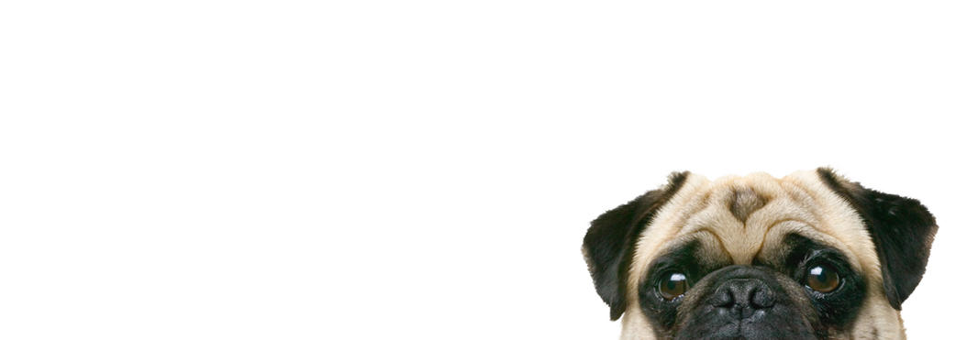
Contents
Introduction
Schedule & Progress
Problems & Solutions
Plans
Q&A

Slide 3
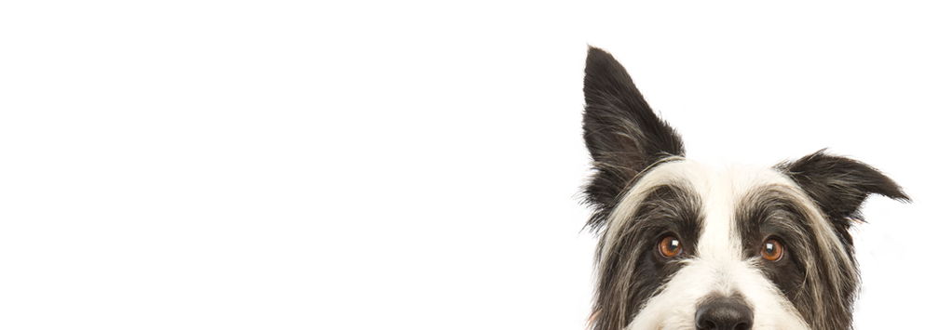
1. INTRODUCTION

Slide 4
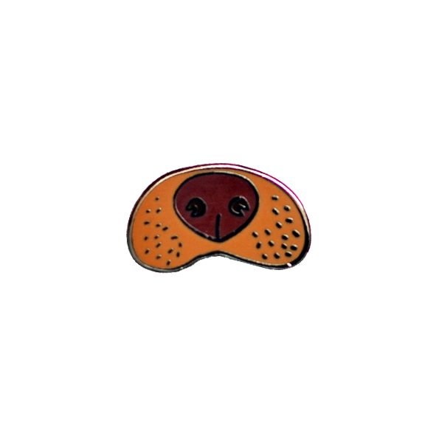

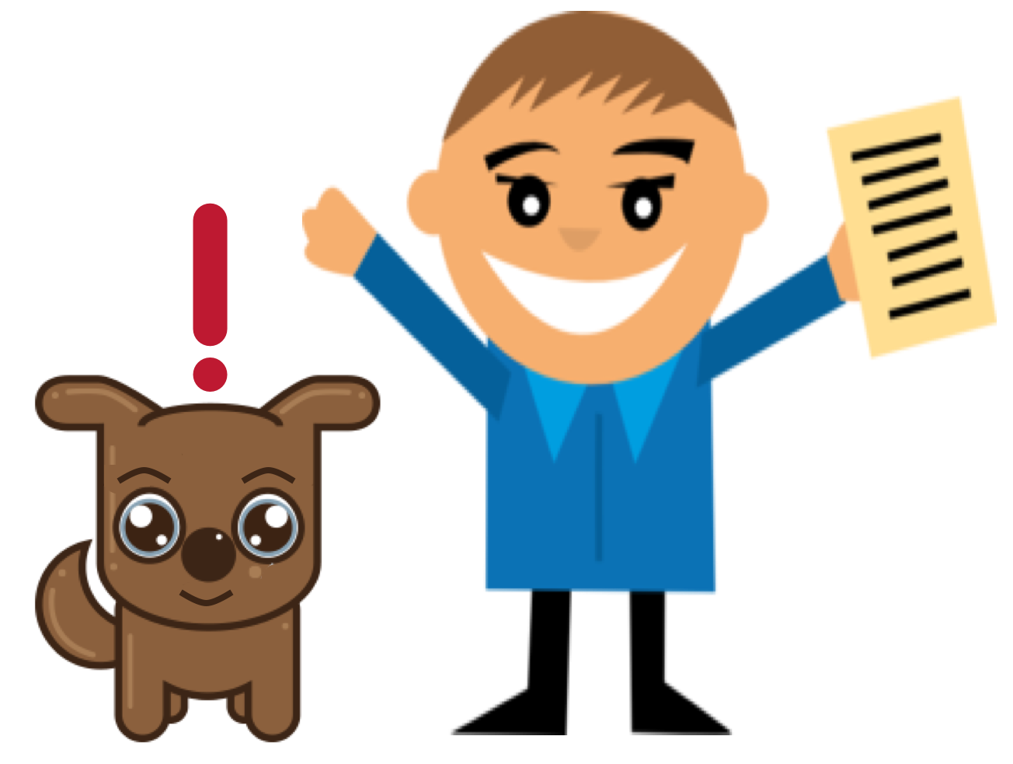


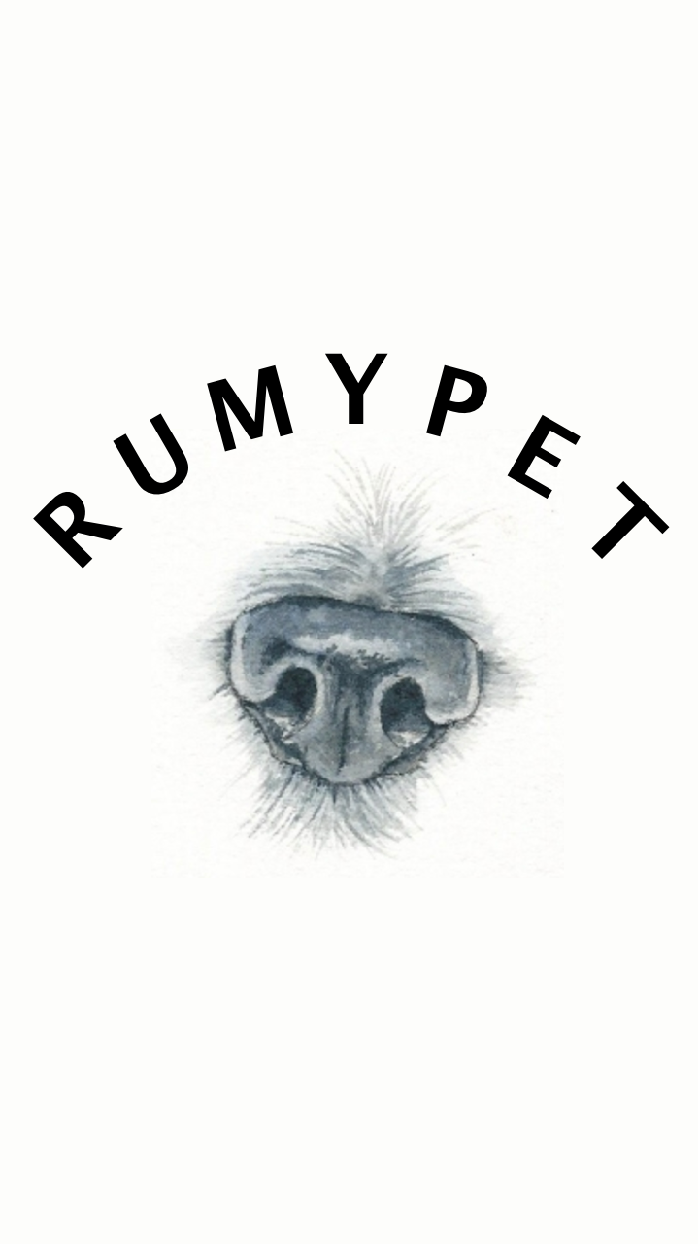
RUMYPET (Are you my pet?)
RUMYPET is a Mobile Application
that can register Identification to the dog
by taking a picture of their nose.
Using this Application, we can find the lost dog’s owner.
4
Notes:
Or we can apply it to many other parts.

Slide 5
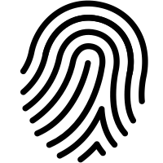
HOW?
Every dog’s nose shape is different.
Same Principle as fingerprint in Human Side
We tried to find the feature of dog’s nose,
And get the identification of each dog
Using Computer Vision Technology
5

Slide 6
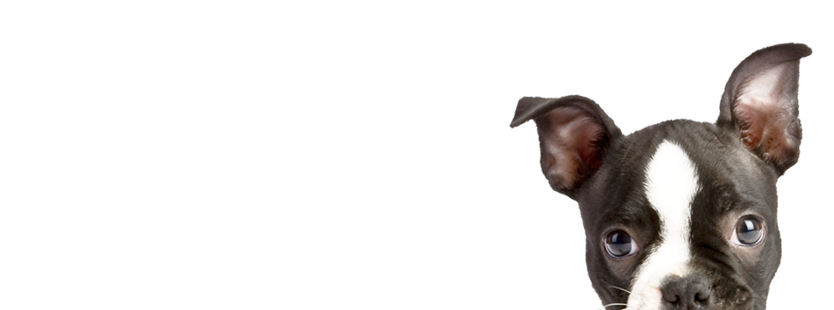
2. SCHEDULE & PROGRESS

Slide 7
SCHEDULE
Week | To-Do (can be changed)
Week 1 | Project goal setting
Week 2 | Propose project
Week 3 | Design: User Interface, System Architectures Setting : Development Environment,
Week 4 | Workshop for collecting data set( Dog cafe, park, .. etc) Hong : Launching AWS server environment Chan : Applying Design to Android Studio Paeng : Develop Pre-processing Method and apply it to Fingerprint picture.
Week 5 | Hong : build the basic code in the server Chan : Develop Android Application Paeng : Apply Pre-processing method to the dog’s nose picture using python opencv.
Week 6 | Hong : Complete the developing basic Server Core Chan : Develop Android Application Paeng : Develop Feature Detecting & Matching
Week 7 | Hong : connect the server and application Chan : Complete Android Application Paeng : Refactoring Python Code to get good performance
Week 8 | Midterm Examination
Midterm Demonstration
7

Slide 8
Week 9 | Hong : sync with server Paeng : sync with client Chan : Intermediate check of our development status
Week 10 | Hong : complete the server and android application. Paeng : complete the Application UI Chan : complete the algorithm.
Week 11 | We will meet together and feedback each other’s code.
Week 12 | Hong : Implement improvement factor at Server Paeng : Implement improvement factor at algorithm Chan : Implement improvement factor at application UI
Week 13 | First Demonstration and feedback
Week 14 | First Revising our project
Week 15 | Final Demonstration
Week 16 | Final Examination
SCHEDULE
for the future...
8

Slide 9
Role of this week
Week 7 | Hong : Connect the Server (Node JS) and Android Application Chan : Complete Android Application Paeng : Refactoring Python Code to get a good performance
Week 4 | Workshop for collecting data set ( Dog cafe, park, .. etc)
Midterm Demonstration
9

Slide 10

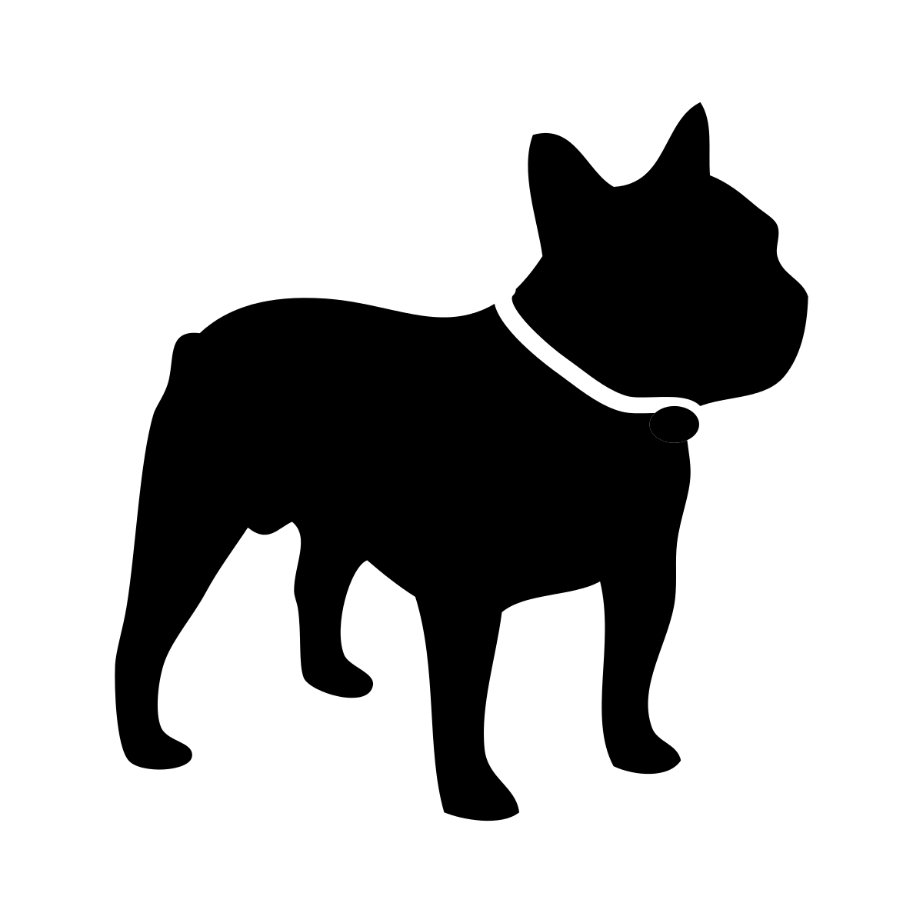
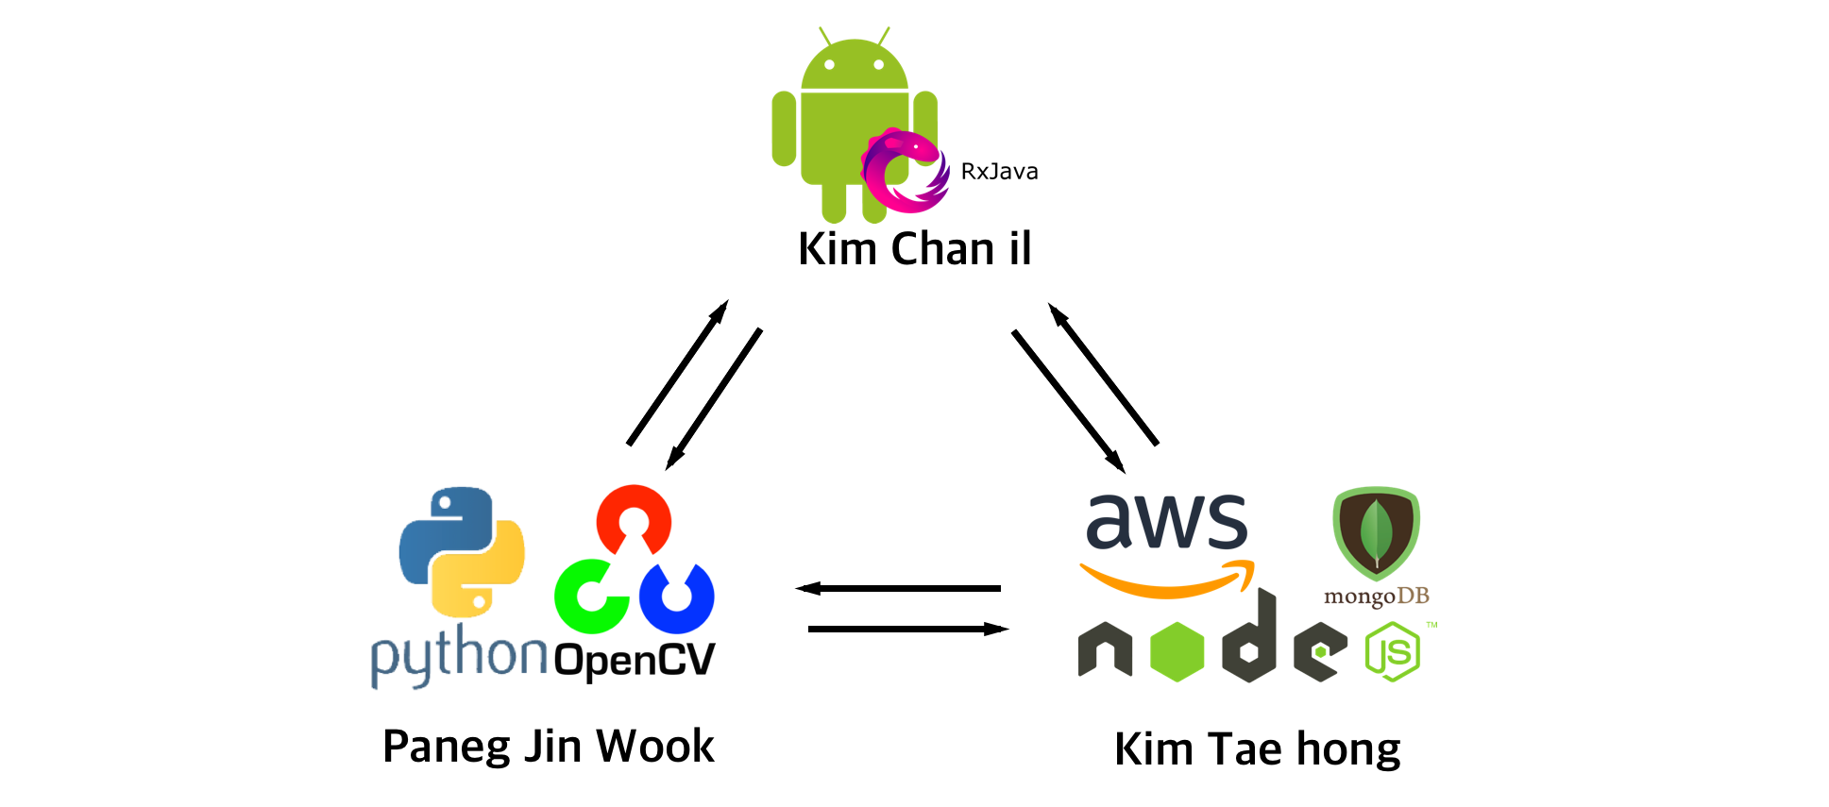
Schedule & Progress
“Our Works can divided into Three Parts.”
https://github.com/GrozaTeam/Rumypet
10
Notes:
As I said before, Our works can divided into 3 parts.
Android, Python, and Server Node JS.
These are the roles that we take.
#
And we use github to control the version.
This URL is the repository of our organization.
we commit about one hundred so far.

Slide 11
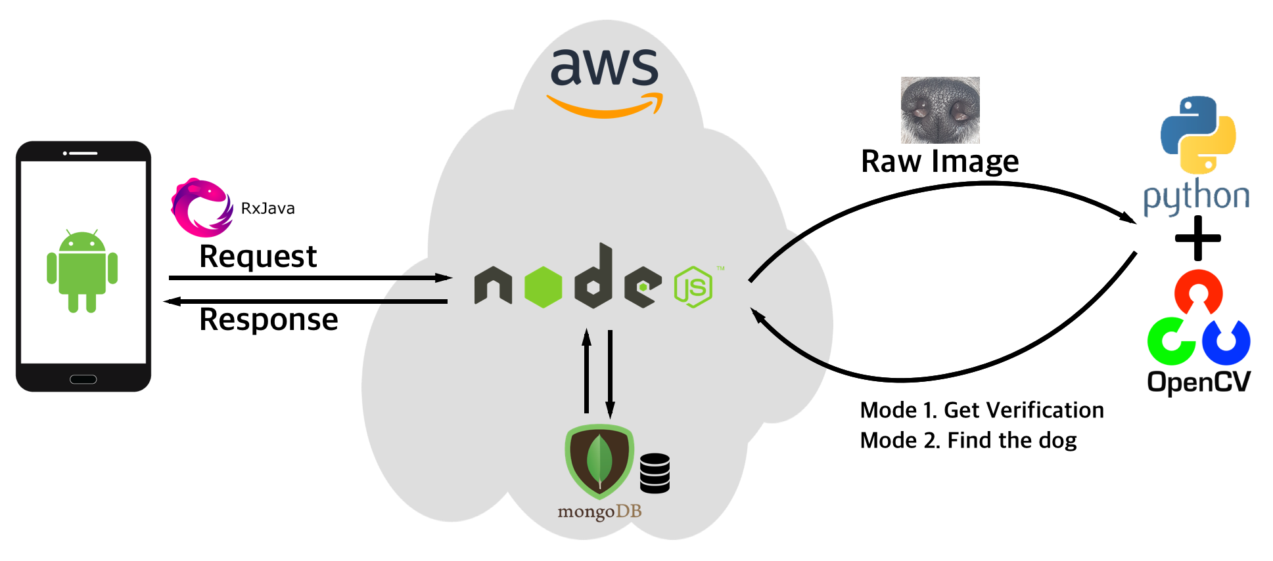
Schedule & Progress
“Flow of the User case”
Coming Soon...
Rumypet
11
Notes:
This is the flow of the user case.
We request and respond to the Server launched by node JS in Amazon Web Service EC2.
We completed to connect the NodeJs Server and Android Application.
And also we have many progresses in Computer Vision part.
#
But we didn’t connect these two yet. These are going to be done later.

Slide 12
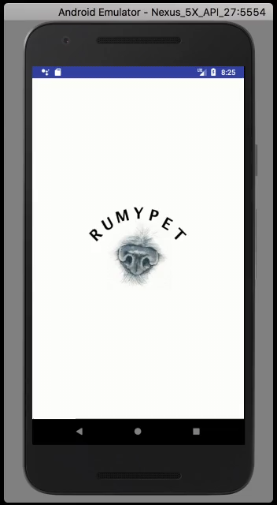
Schedule & Progress : Android & Server
(Kim Chan il, Kim Tae hong)
”Use Case Video of RUMYPET”
12

Slide 13

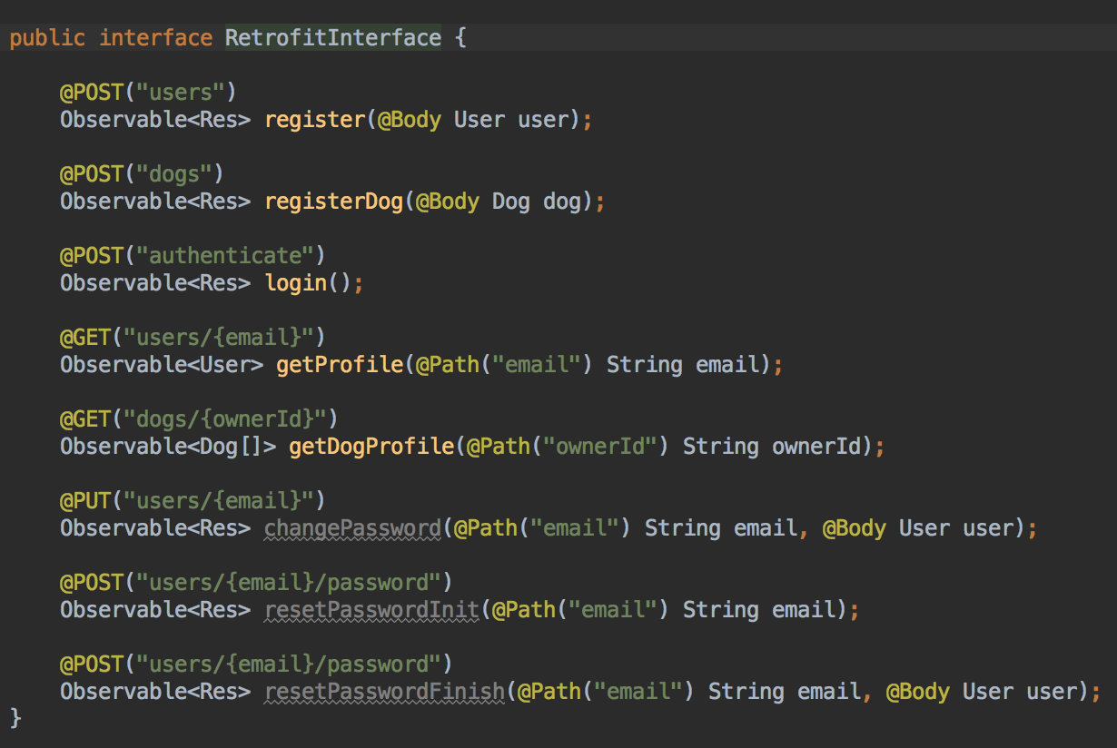




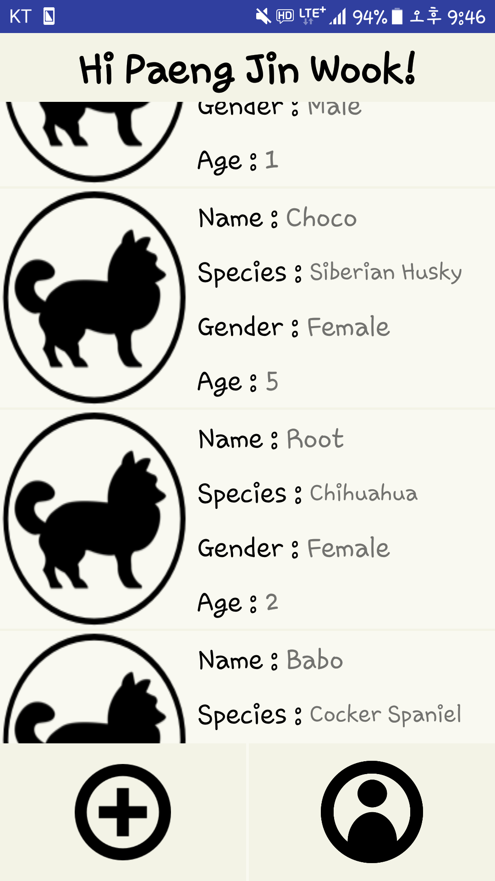
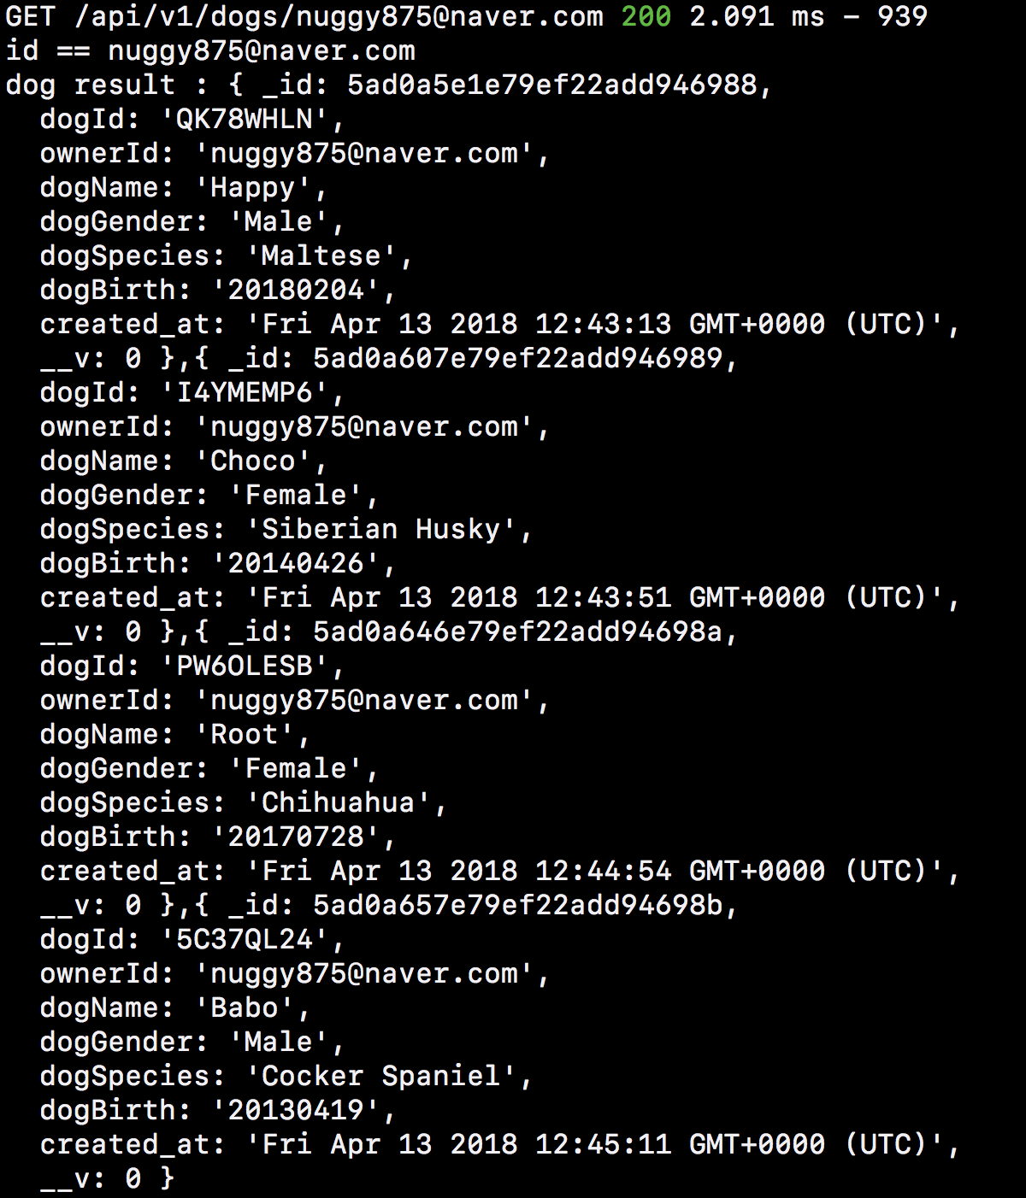
Schedule & Progress : Android & Server
(Kim Chan il, Kim Tae hong)
”We Could connect with the server Using RxJava and Retrofit ”
Request
HTTP Method : GET and POST
13.209.12.207:8080
Response
13
Data : JSON File
Notes:
This is our progress for the android and the server
We could connect with the server using RxJava and retrofit
We used http Method Get and Post
When User try to register or Login, The Method is ‘POST’
When User try to get data, The Method is ‘GET’
We load the data by JSON File.
Through Parsing process, we successfully show the data in android application.

Slide 14

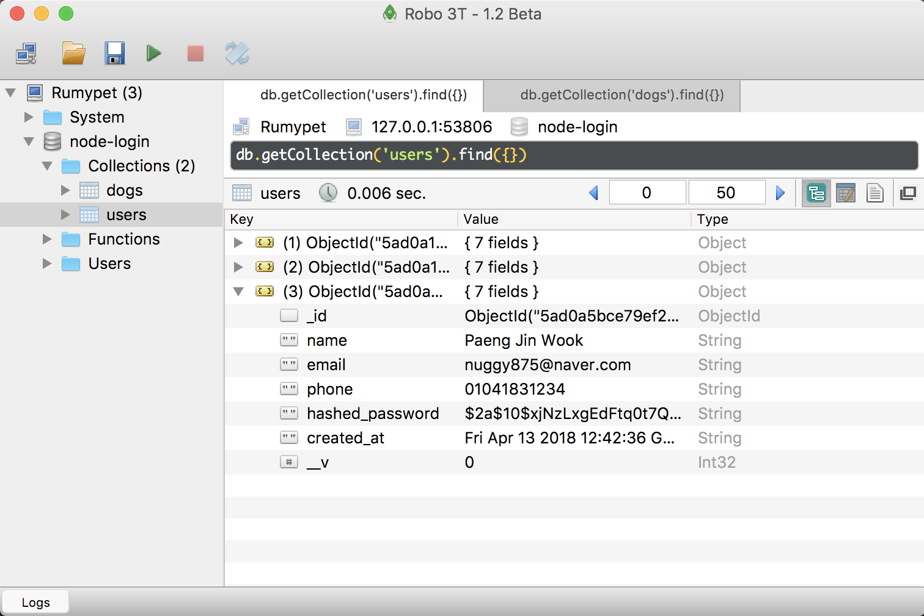
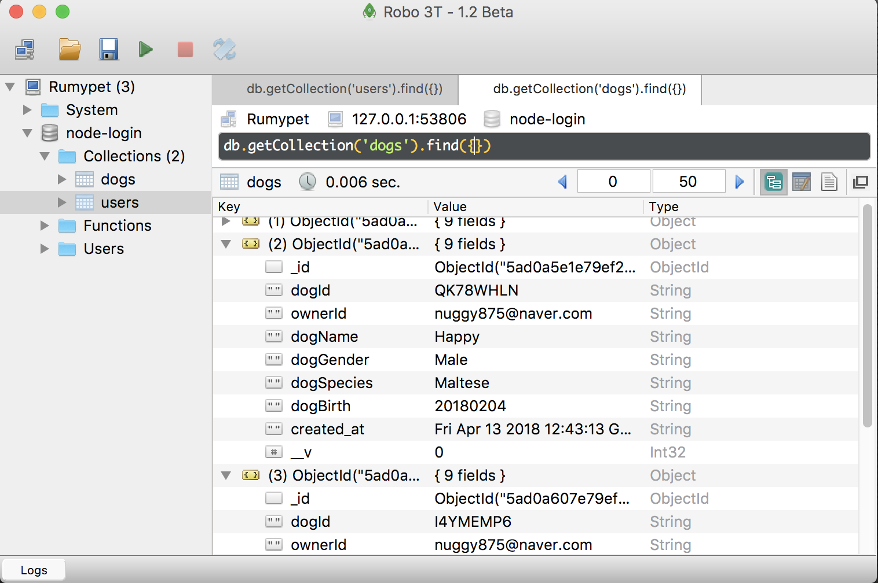
Schedule & Progress : Android & Server
(Kim Chan il, Kim Tae hong)
”We manage our datas in MongoDB using RoboMongo (Robo 3T)”
User Table
Dog Table
14
Notes:
The Password is encrypted for security

Slide 15
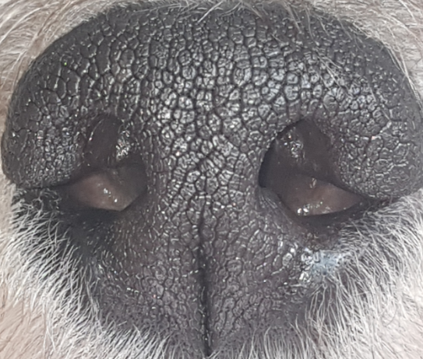
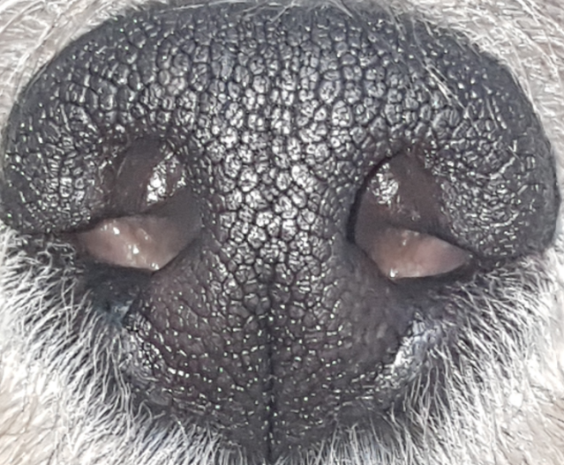


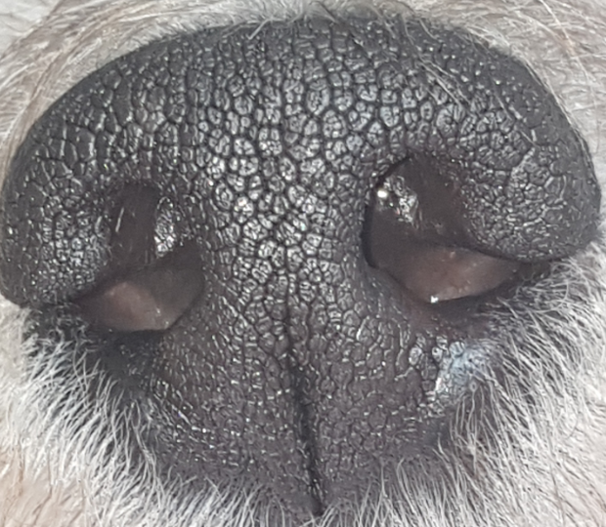
Schedule & Progress : Python
(Paeng Jin Wook)
”We Assumed that Python Code is connected to the Server
and then developed the process”
· Mode 1 : Verification
Database
Input Image
(Dog A)
The image is Dog A
(Correct!)
Dog A Datas
15
Notes:
As I said, Python code is not connected to the server yet.
So we assumed that python code is connected to the server and then developed the process.
Mode 1 is verification. Same Principle with certifying myself with my fingerprint.

Slide 16
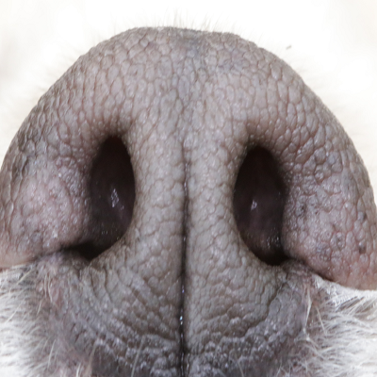
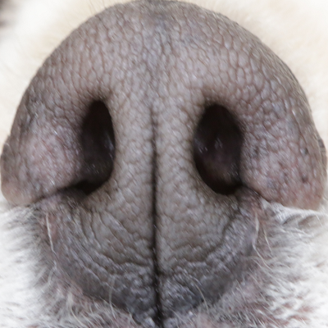
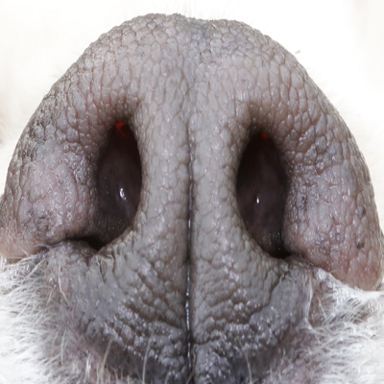
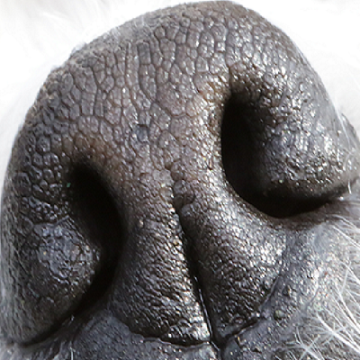
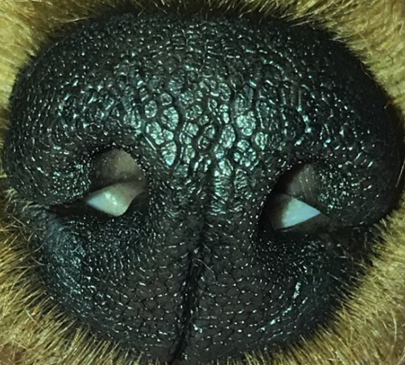
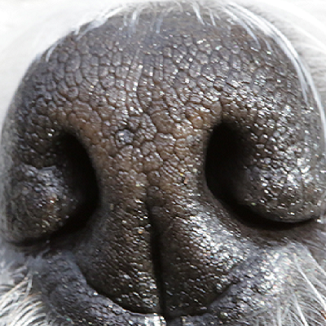
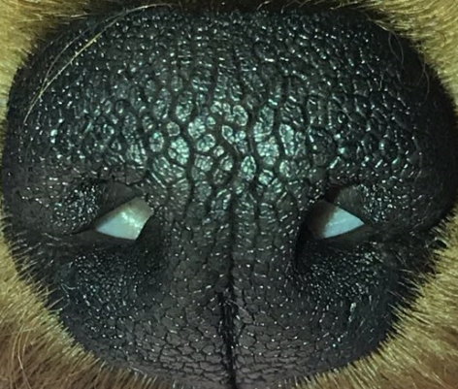
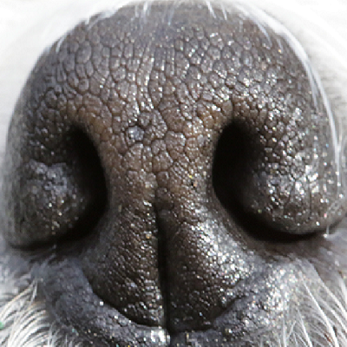
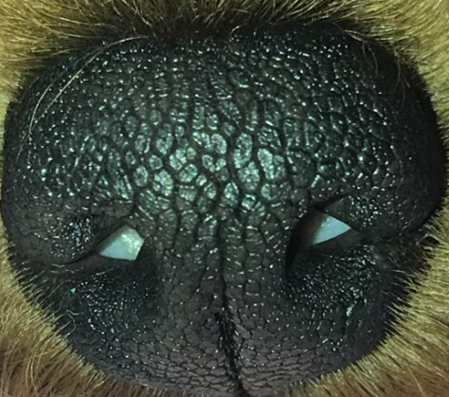
Schedule & Progress : Python
(Paeng Jin Wook)
”We Assumed that Python Code is connected to the Server
and then developed the process”
· Mode 2 : Identification
Database
Input Image
(Whose dog it is?)
The image is Dog A
Datas
16
Notes:
Mode 2 is identification. This is for searching whose dog it is.
We firstly give attention to develop the Mode 1 first.

Slide 17
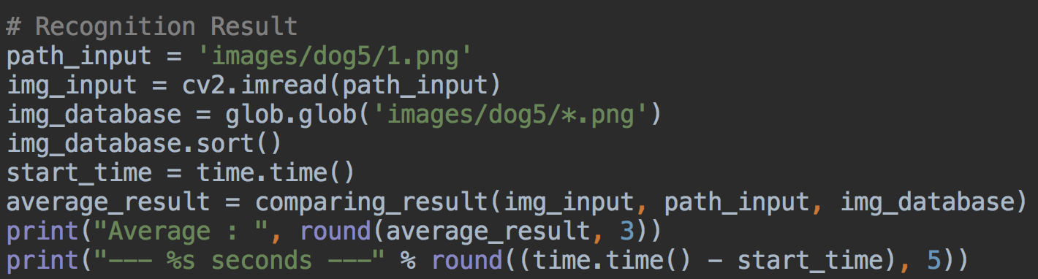
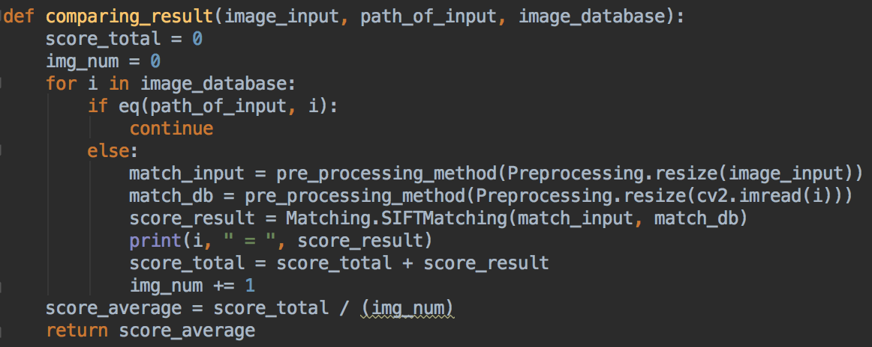
Schedule & Progress : Python
(Paeng Jin Wook)
”Python Code.”
Dog 5 Input data
Load Datas in Dog 5 Folder
Preprocessing Method
SIFT Matching Method
Get Average
17
Notes:
This is the python code.
The python code is so long, so I take the main point of it

Slide 18
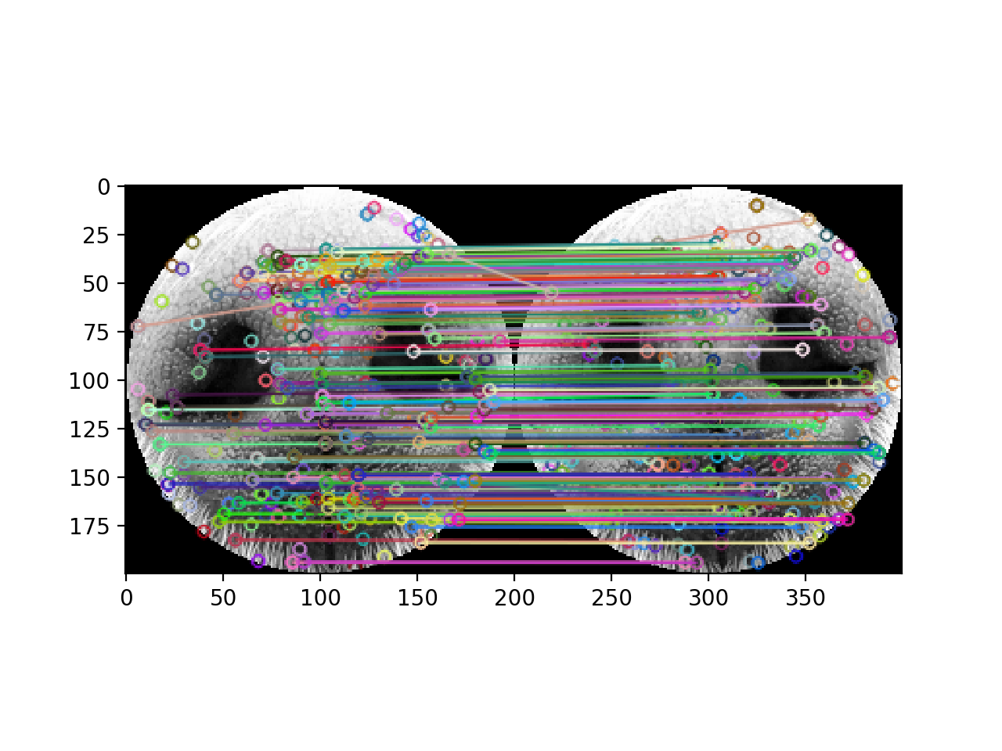
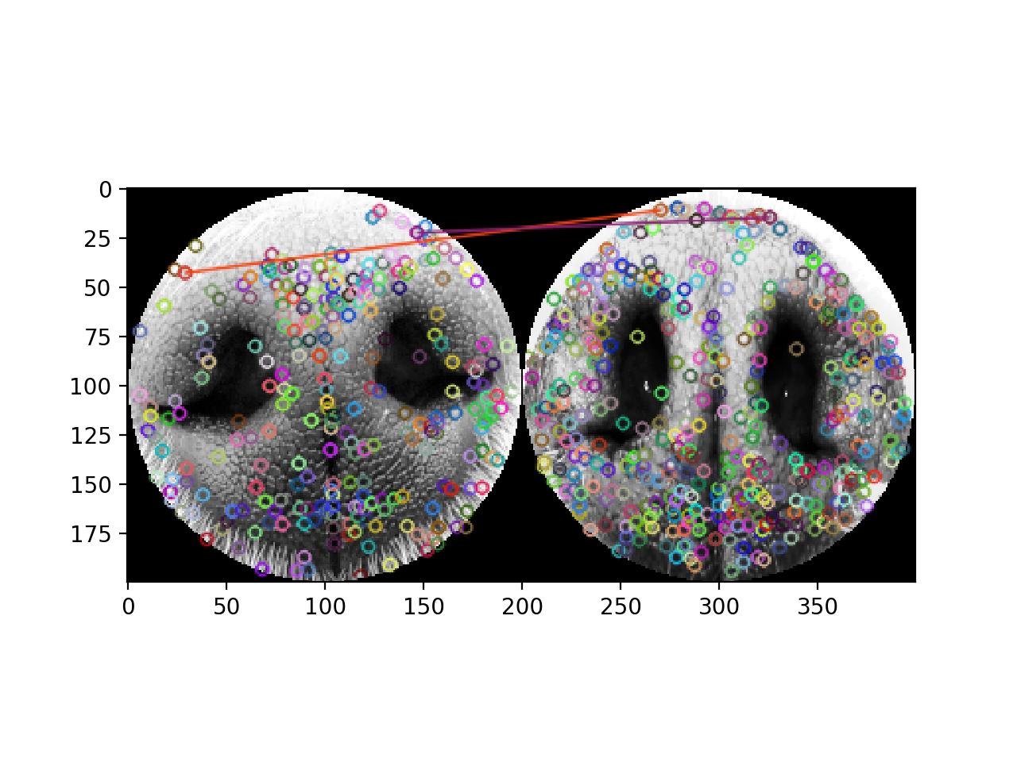
Schedule & Progress : Python
(Paeng Jin Wook)
”Matching Result.”
Same Dog
Different Dog
Result : about 20~115.5
Result : about 0~3
18
Notes:
This is the Matching result shown by opencv GUI
When comparing datas are same dog, the matching result comes out about 20 ~ 115.5.
When comparing datas are different dog, the matching result comes out about 0~3.
These are the average value. not always that results come out.

Slide 19

Schedule & Progress : Python
(Paeng Jin Wook)
Performance Measurement
19

Slide 20
2. PROBLEMS & SOLUTION

Slide 21
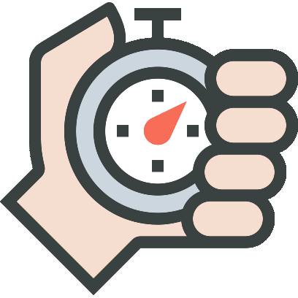

PROBLEMS & SOLUTIONS
Problem 1
For Accuracy, It was necessary to compare several pictures with input data.
But It took so much time...
SURF Matching function was faster than SIFT
But the performance was not good.
Solution 1
When Preprocessing method process, we reduce the pixel of the data.
In Other words, we reduce the size. It becomes much faster!
21
Notes:
--ppt reading--
Now, we have our own server!

Slide 22
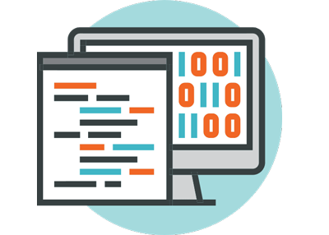
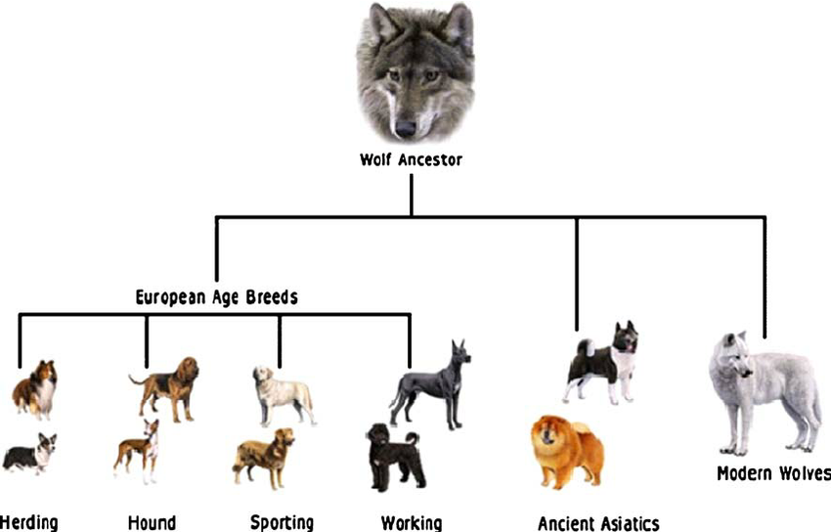
PROBLEMS & SOLUTIONS
Problem 2
Now it becomes faster. but when we search the dog with the unknown data,
We have to compare all the data in the database. (Mode 2)
So much time will be taken...
Solution 2
Later we need some classification of the dog datas.
That’s why we put the Species in data column.
After we classify the dog datas by species,
We could save much more time.
22
Notes:
--ppt reading--
Now, we have our own server!

Slide 23
3. PLANS

Slide 24
PLANS from now on
Connect this part
24
Notes:
ppt reading

Slide 25

PLANS from now on
Perfectly complete Developing the Android Application
25
Notes:
ppt reading

Slide 26
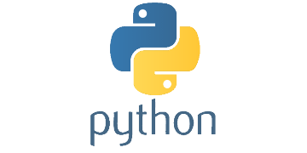
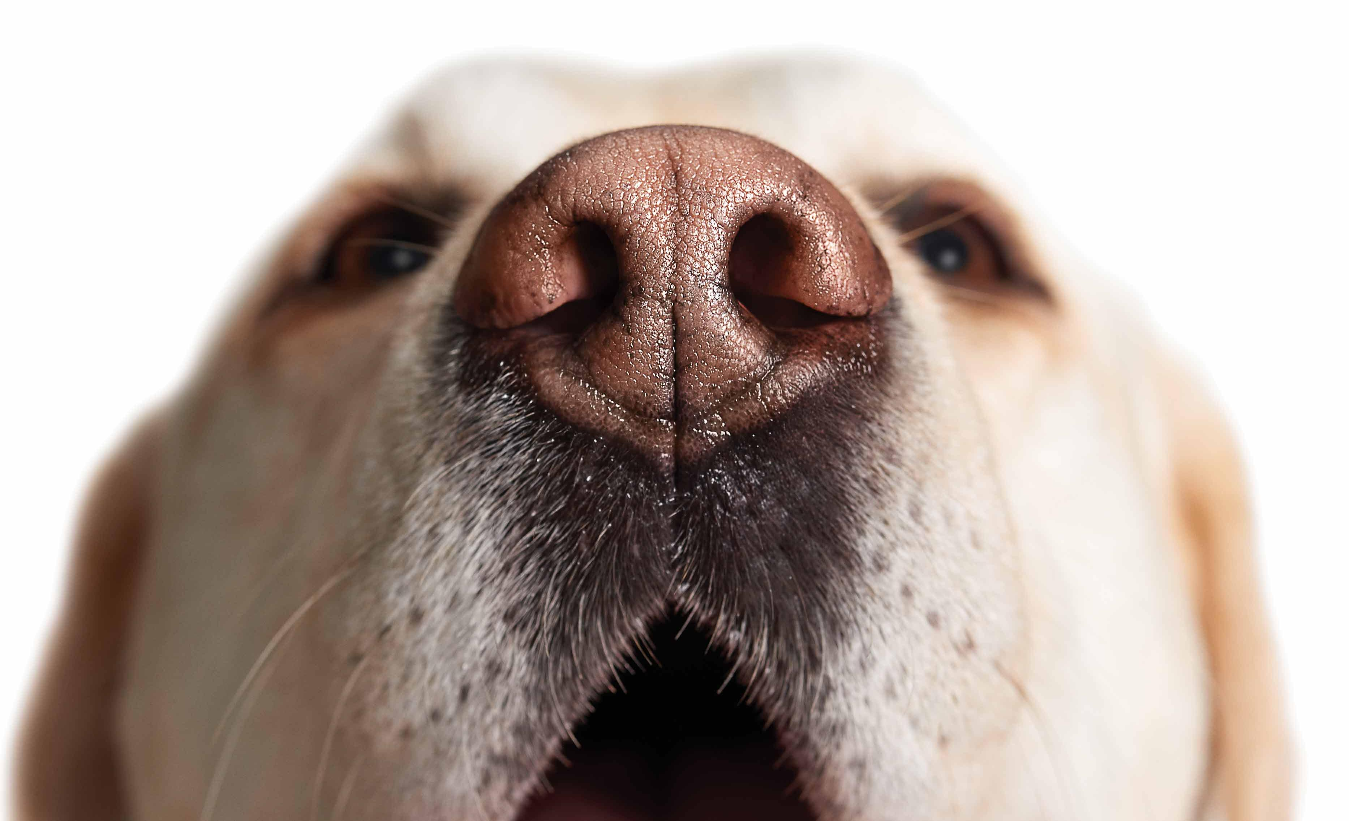

PLANS from now on
Refactoring the Python code to get better Performance.
24
Notes:
ppt reading

Slide 27
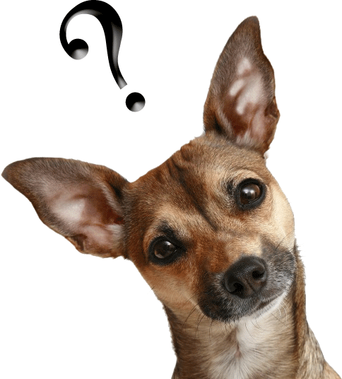
Q&A
Notes:
These are what we have done, and what we are going to do.
Any question?

Slide 28
Thank you!

